Slide 1
Cafe Culture
in Berlin

Slide 2
Main Question and Theme
What kind of coffee, and kind of cafe experiences, exist in Berlin?
Will I like the coffee, the cafes, and how do they differ from America?
Can also compare and contrast with France, if I feel like getting extra fancy

Slide 3
What connection does the film have to readings, films, and themes in the course?
Cafe Nagler
Cafes in Berlin as pillars of history and connection to the past

Slide 4
Audience
me
Coffee lovers
People who work at cafes
People interested in German culture

Slide 5
Music
Java Jive, as done by Pacific’s treble voice acapella group Vera Voce

Slide 6
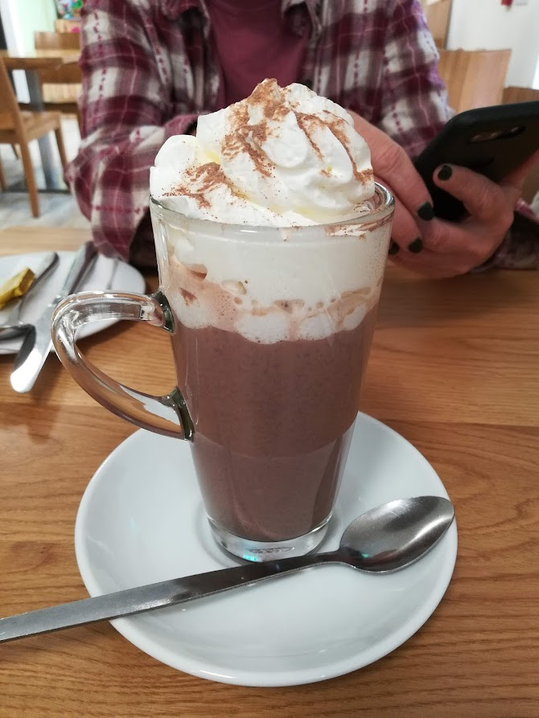
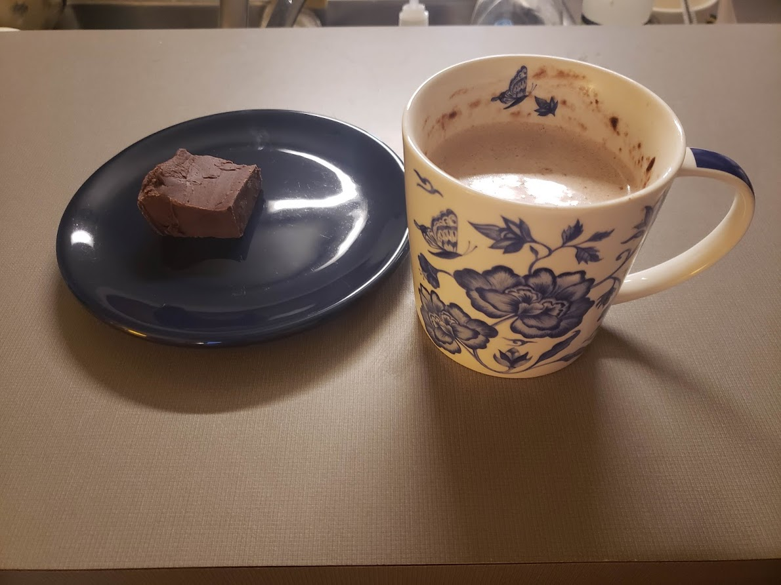
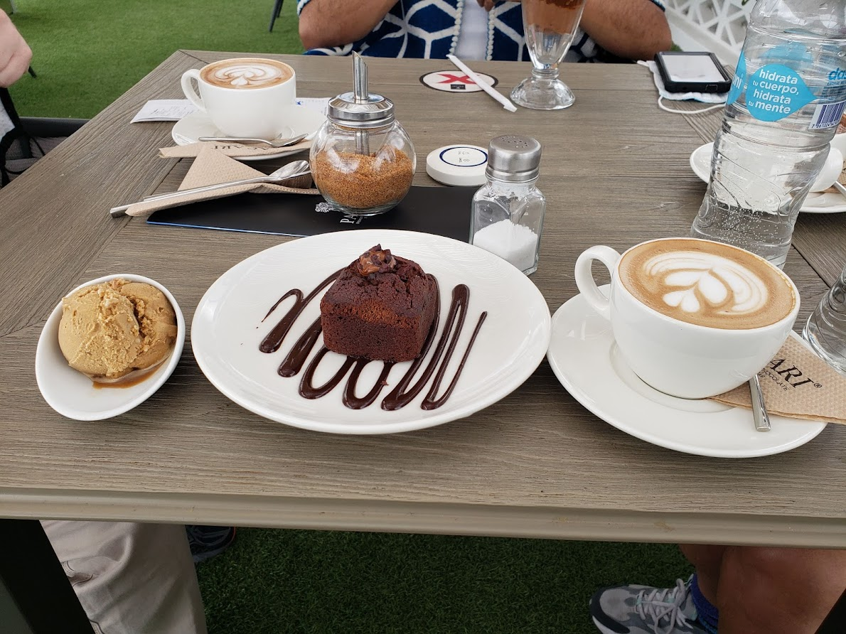
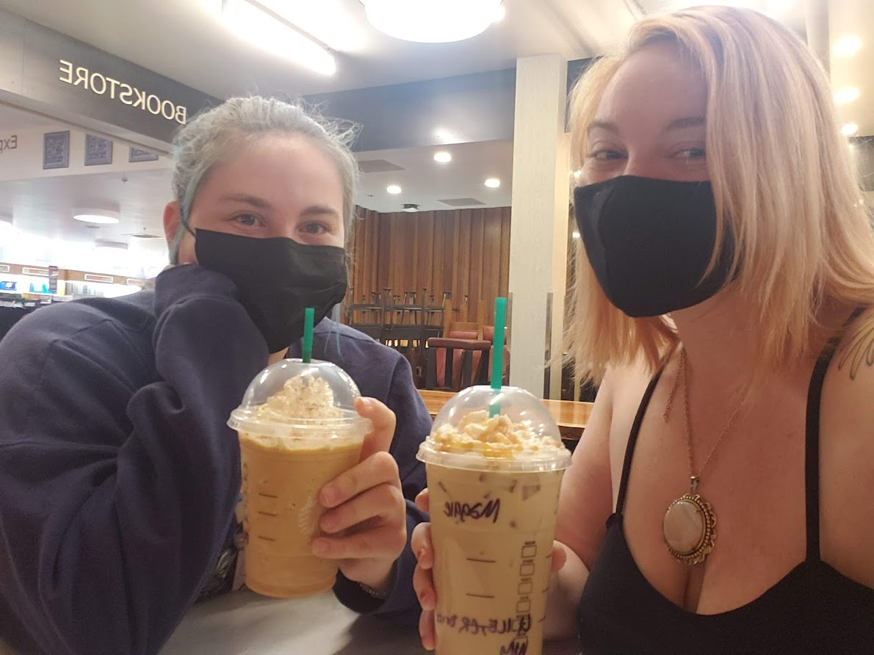
Camera Angles

Slide 7
Equipment/Costumes/Props
Equipment: phone, coffee, money to purchase coffee
Costumes: none
Props: Waverly, Sonja, Rachel, Anjolina, anyone else who also wants to go to these cafes and drink coffee

Slide 8
Challenges/Backup Plans/Flexibility
Challenges:
the fancy or well known coffee shops aren’t nearby our hostel
I like sweet coffee and that is sometimes difficult to get in Europe
Back up plans:
I could get coffee pretty much anywhere
Flexibility:
I could get coffee pretty much anywhere.
The fancy or well known coffee shops can be acquired via transportation
If i get an unsweet coffee, I can Deal With It Like An Adult

Slide 9
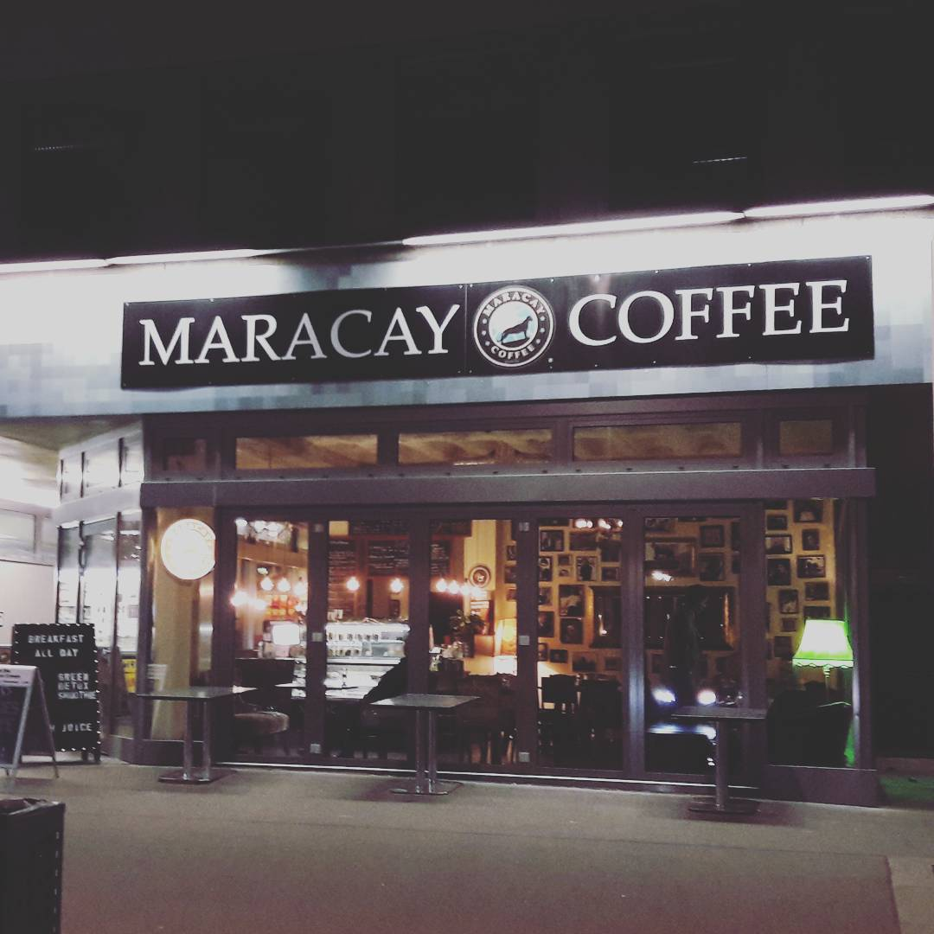
Storyboard
Maracay Coffee
Their slogan is “we make coffee your first love” how cute is that
1 minute away walking
They even have iced coffee hallelujah
https://www.maracaycoffee.de/

Slide 10
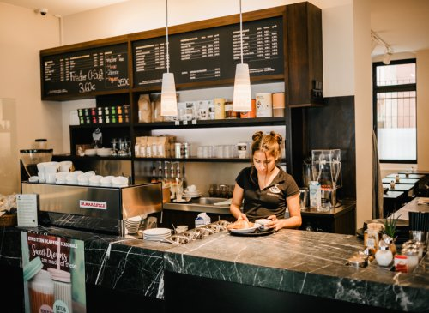
Storyboard
Cafe Einstein
It’s a franchise! There’s many
There’s at least three around 5-6 minutes driving distance away
They’re big on the actual making of the coffee
Someone recommended it to me when I said I was gonna do this, so I’m assuming it’s well known
https://www.cafeeinstein.com/

Slide 11
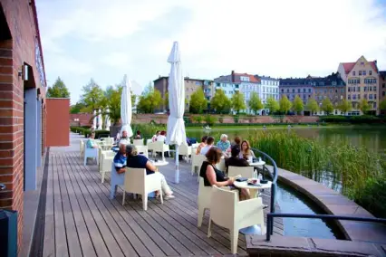
Storyboard
Café am Engelbecken
Seven minutes driving
It’s on a waterfront
Their website does not reveal much else, but we love a mystery
https://cafe-am-engelbecken.de/

Slide 12
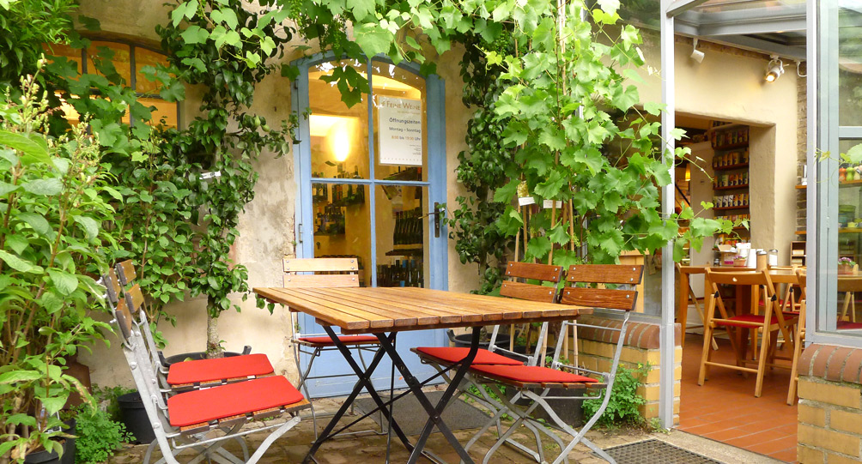
Storyboard
Mutter Fourage Hofcafe Berlin
There’s also a garden, a balcony, and a terrace
And an art gallery
“The name is a play on "Mutter Courage", the German name for Brecht's "Mother Courage,"” -https://www.visitberlin.de/en/mutter-fourage
This is the play I did my presentation about. Full circle moment.
The downside is it’s 30 minutes away, so I’ll probably go here on one of the free days
https://www.hofcafe-berlin.de/

Slide 13
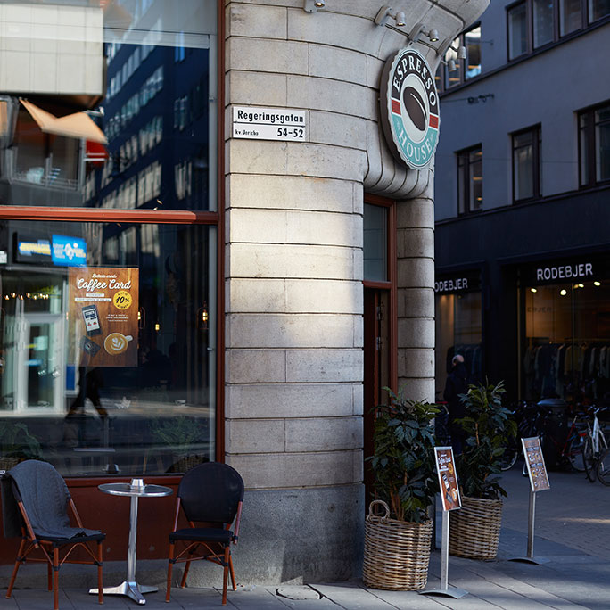
Storyboard
https://de.espressohouse.com/
Espresso House
13 minute walk away
Another franchise
This one is in Potsdamer Platz

Slide 14
Division of Labor
me

Slide 15
Division of Labor
Also my friends who agreed to film me walking into places, drinking coffee, looking cute, etc. etc.
They only have to film the shots I want of myself, and they already said yes

Slide 16
Citations
“Cafe Einstein,” April 6, 2022. https://www.cafeeinstein.com/.
“Espresso House - Passionate about Coffee!” Espresso House - Germany, April 29, 2022. https://de.espressohouse.com/.
“Hofcafé Bei Mutter Fourage - Das Gute Im Leben.” Hofcafé Berlin bei Mutter Fourage, April 12, 2022. https://www.hofcafe-berlin.de/.
“We Make Coffee Your First Love!” Maracay Coffee, n.d. https://www.maracaycoffee.de/.
“Willkommen Zum Verweilen.” Cafe Am Engelbecken, n.d. https://cafe-am-engelbecken.de/.

