Slide 1
Laundry:
Folding Towels
Notes:
This tool is for grading laundry task demands. Suggested as a flip book or task chart. If used as a flip book, client flips to the next page for the next part of the task. If laminated and used as a chart, a grease pencil can be used to mark of each task.

Slide 2
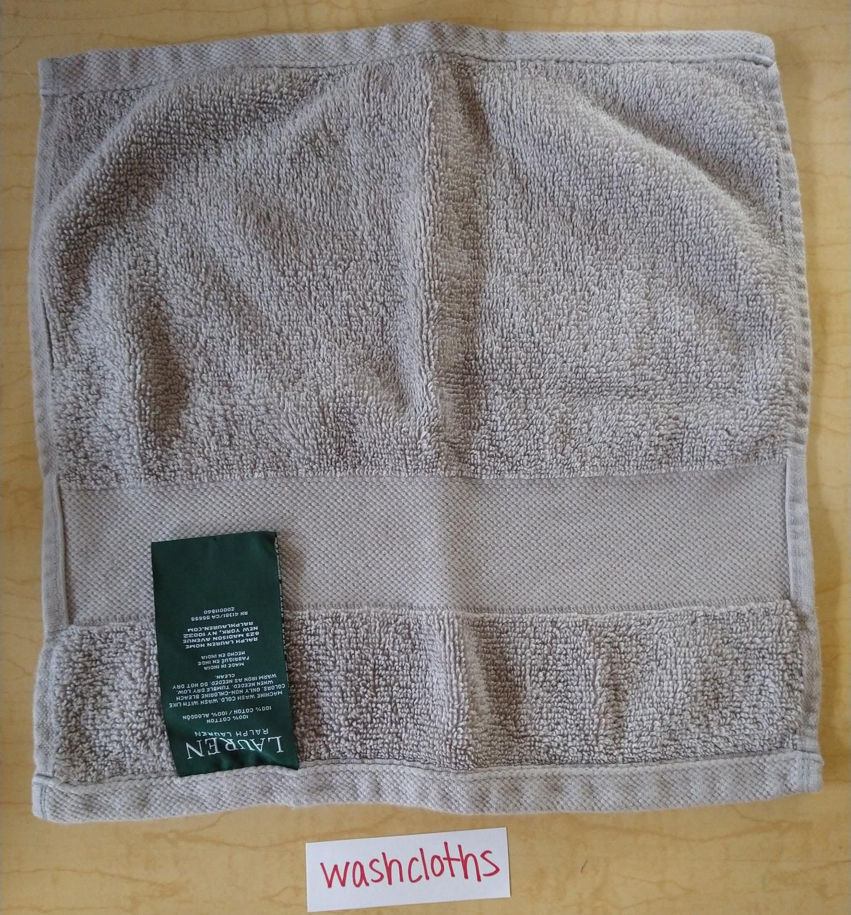
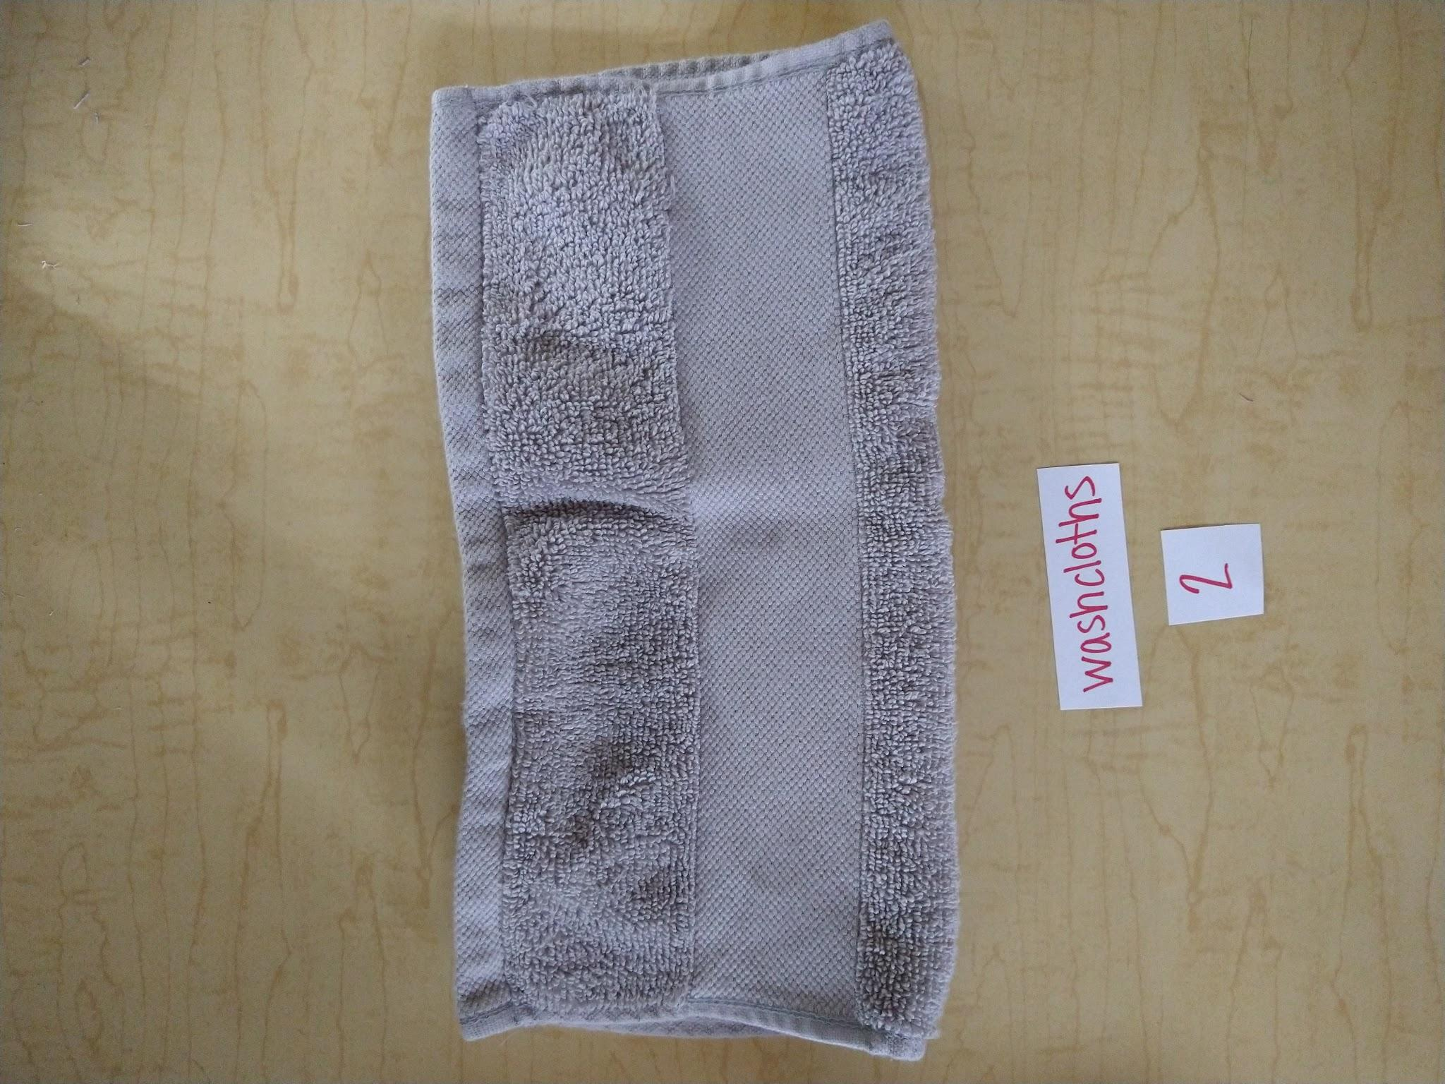
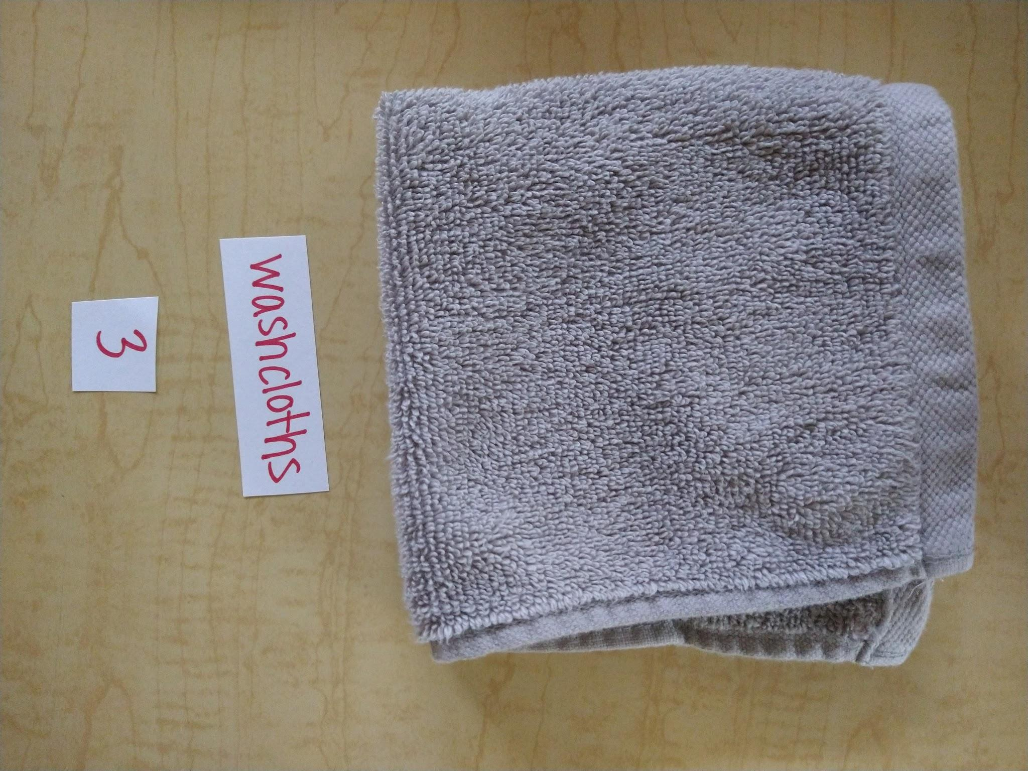
Washcloths
Make it look just like mine.
Look like mine?
Yes
No
2
3
1

Slide 3
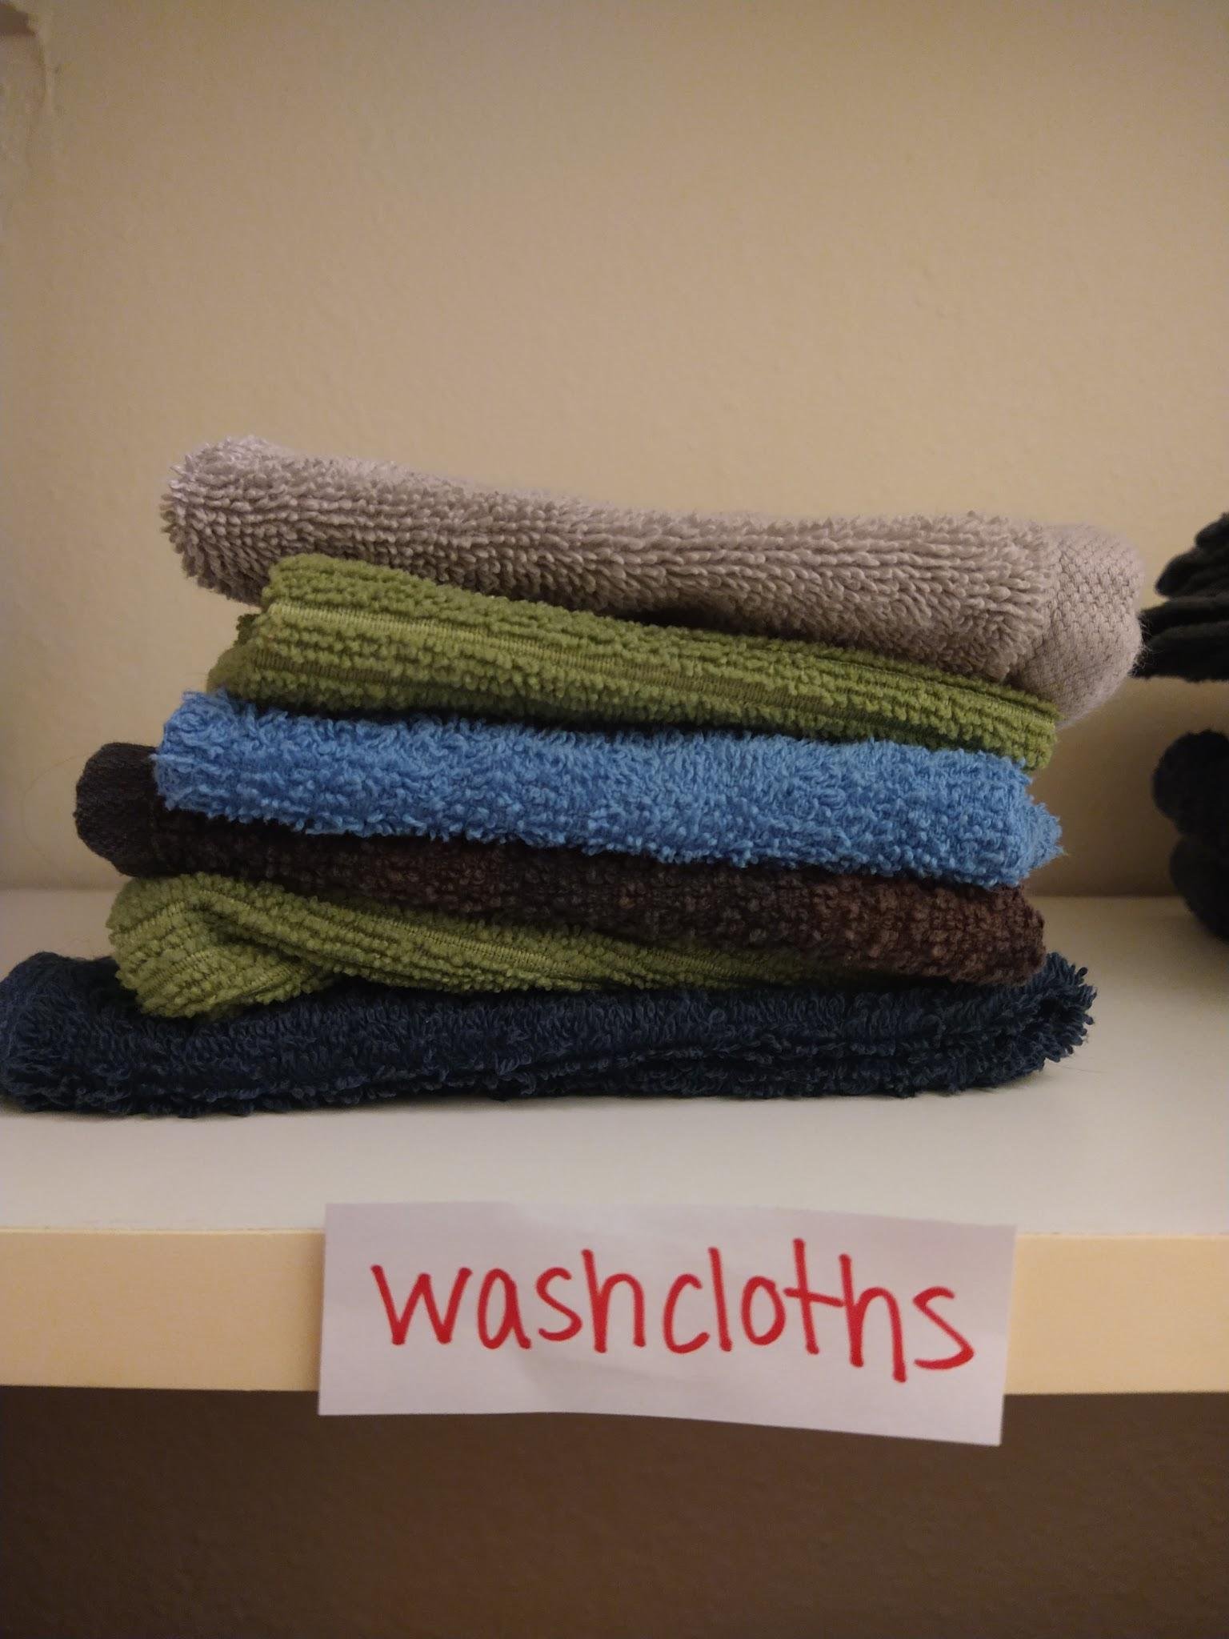
Washcloths
Put away in closet.

Slide 4
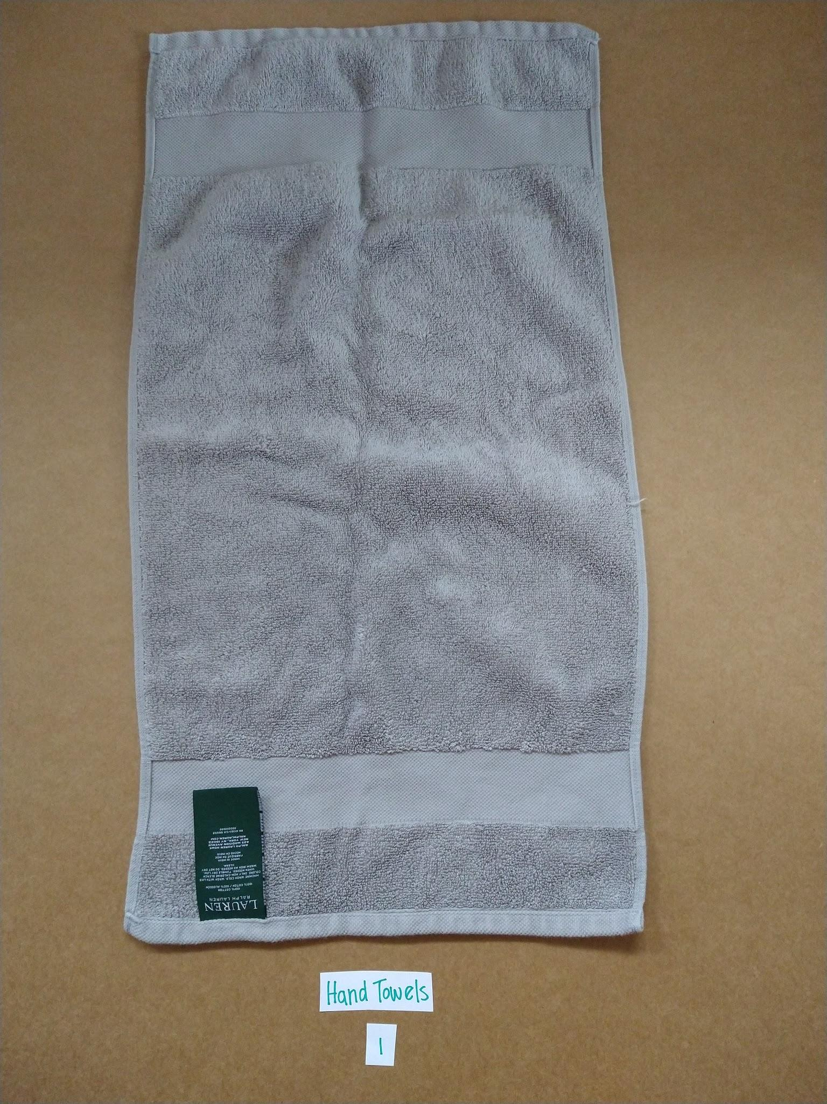
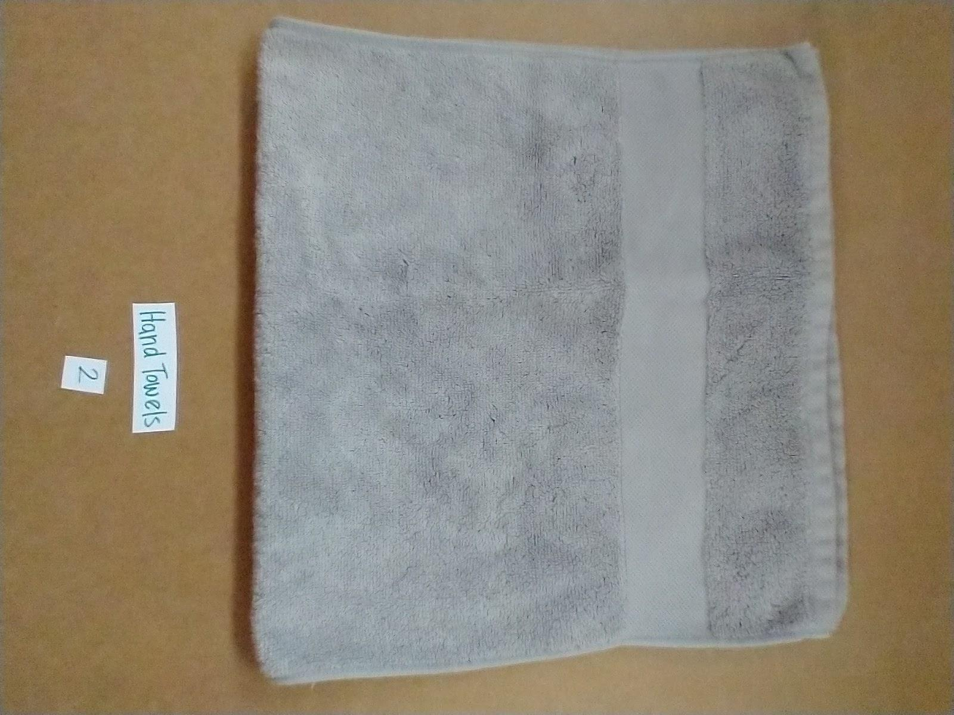
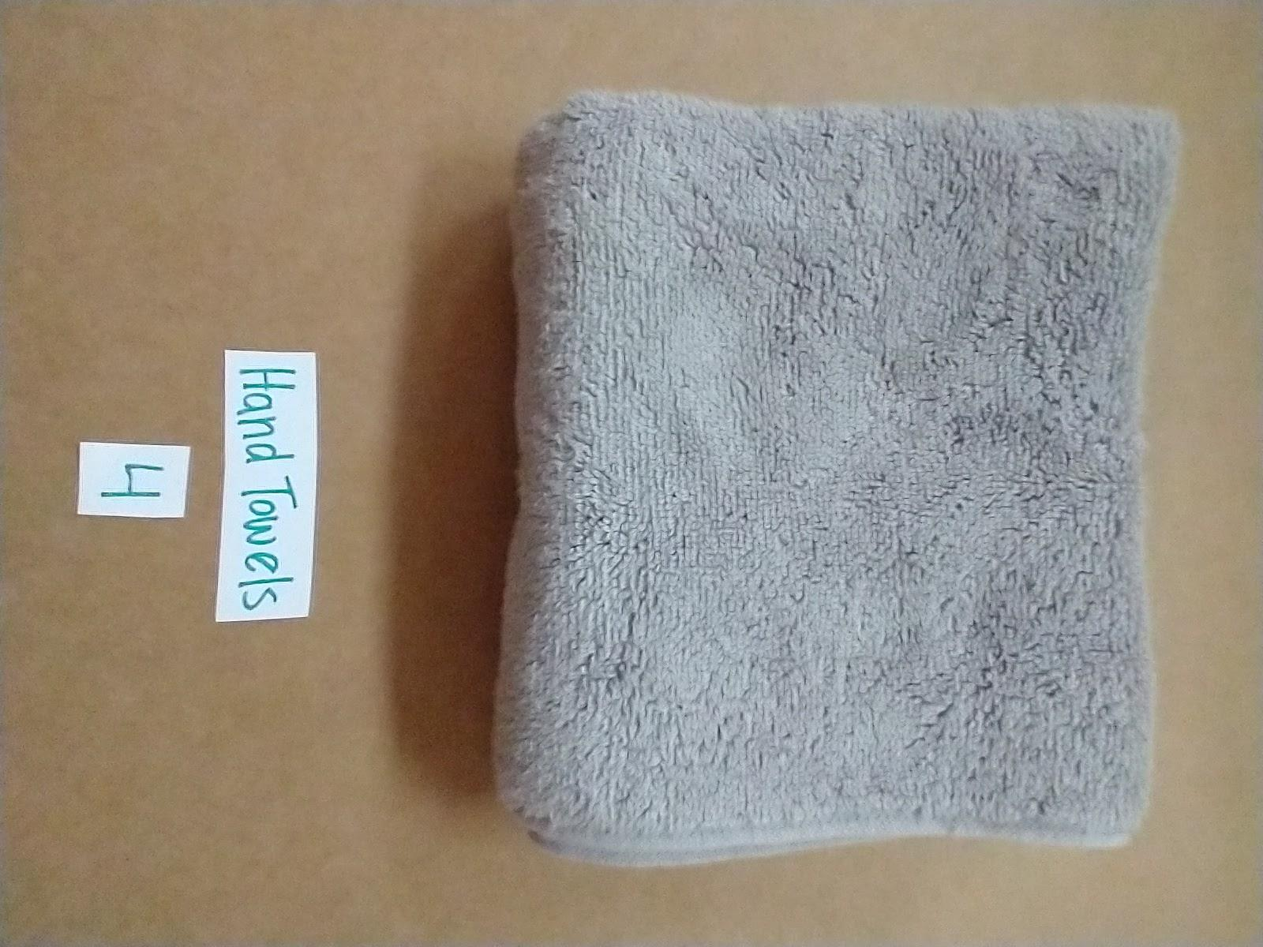
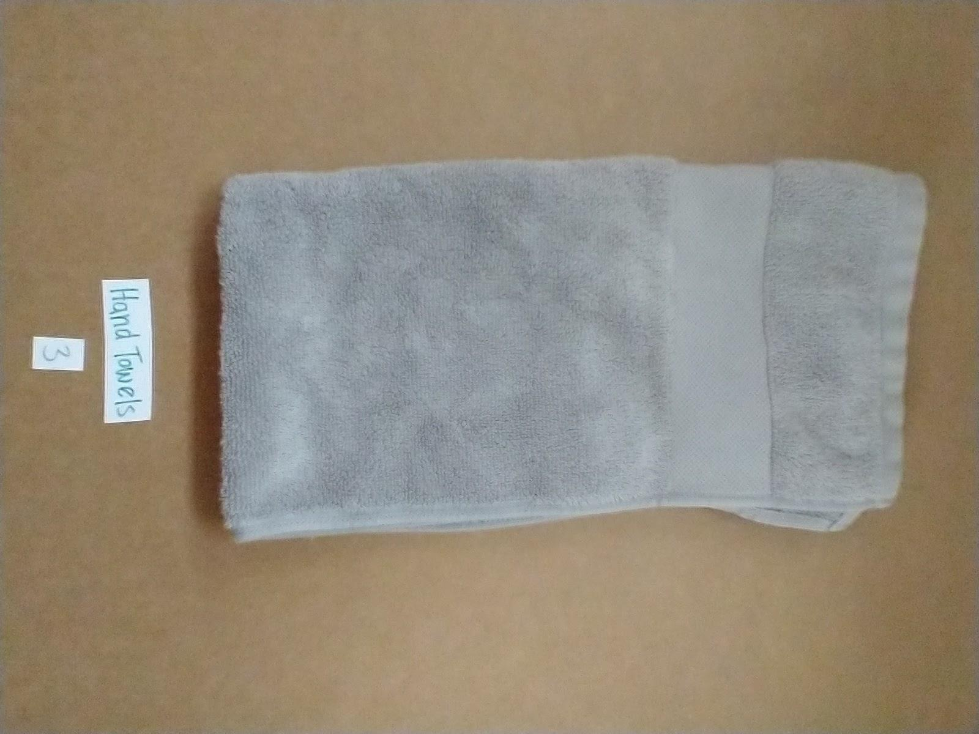
Hand Towels
Make it look just like mine.
Look like mine?
Yes
No
1
2
4
3

Slide 5
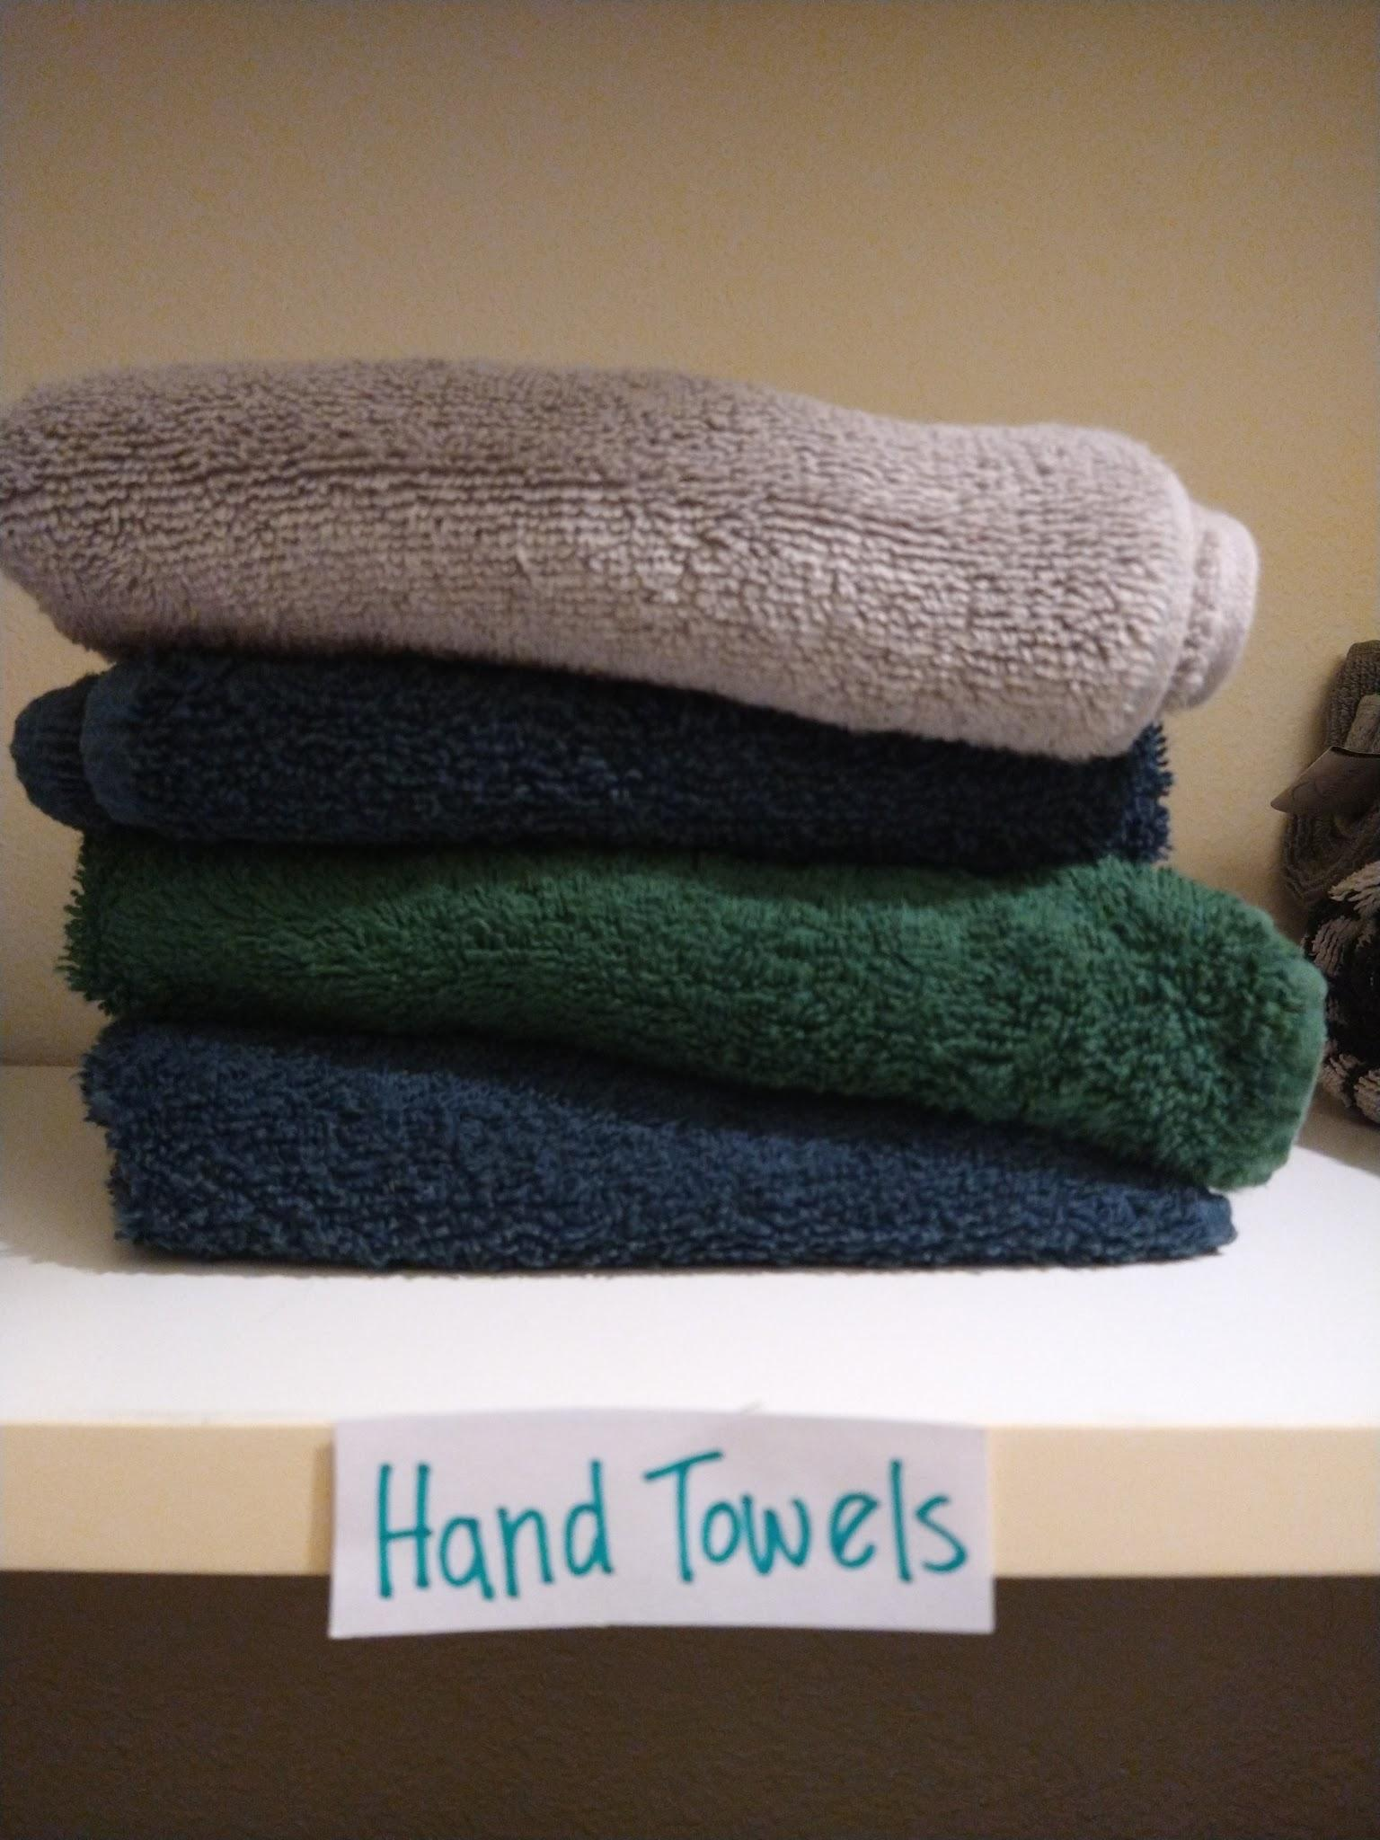
Hand Towels
Put away in closet.

Slide 6
Washcloths & Hand Towels
Put away in closet.

Slide 7
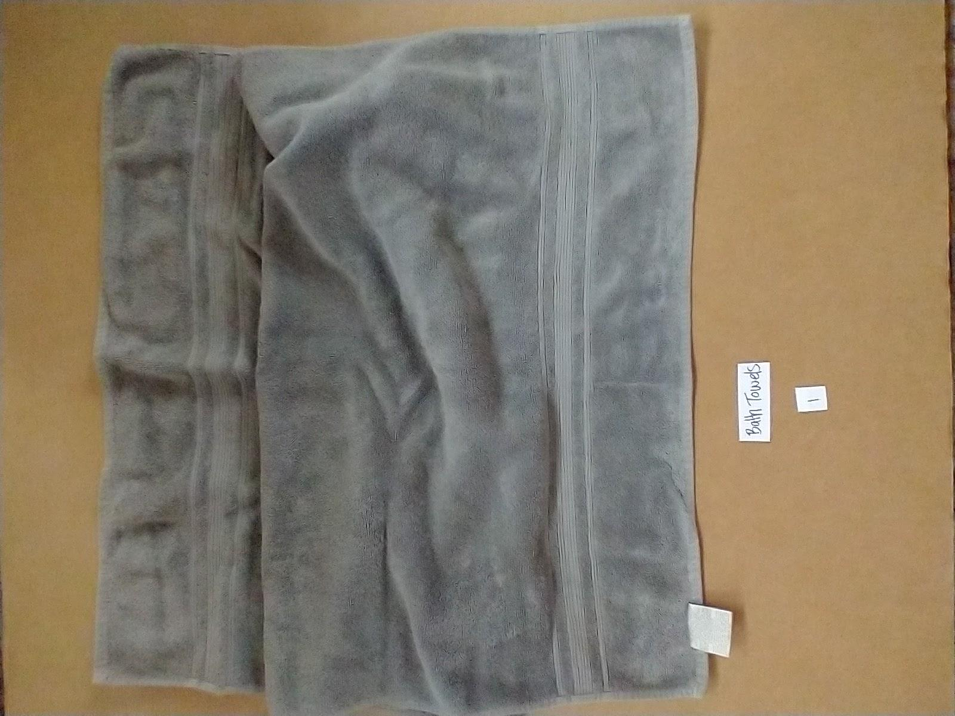
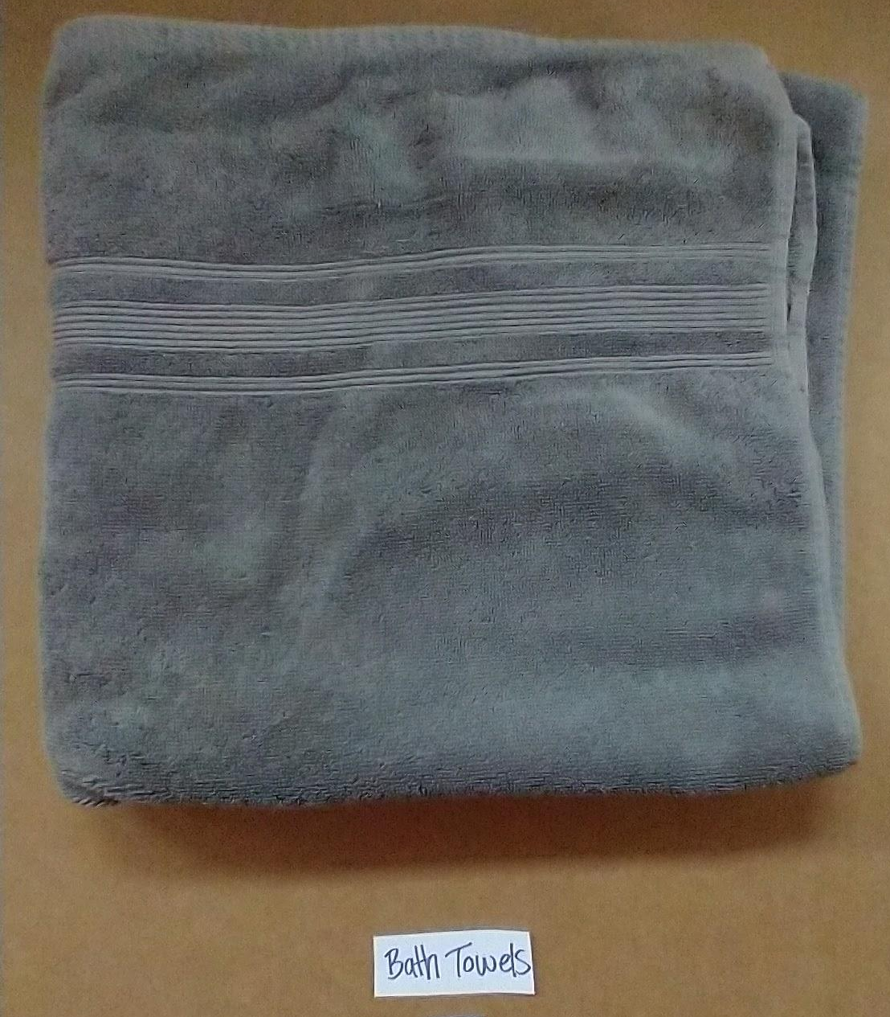
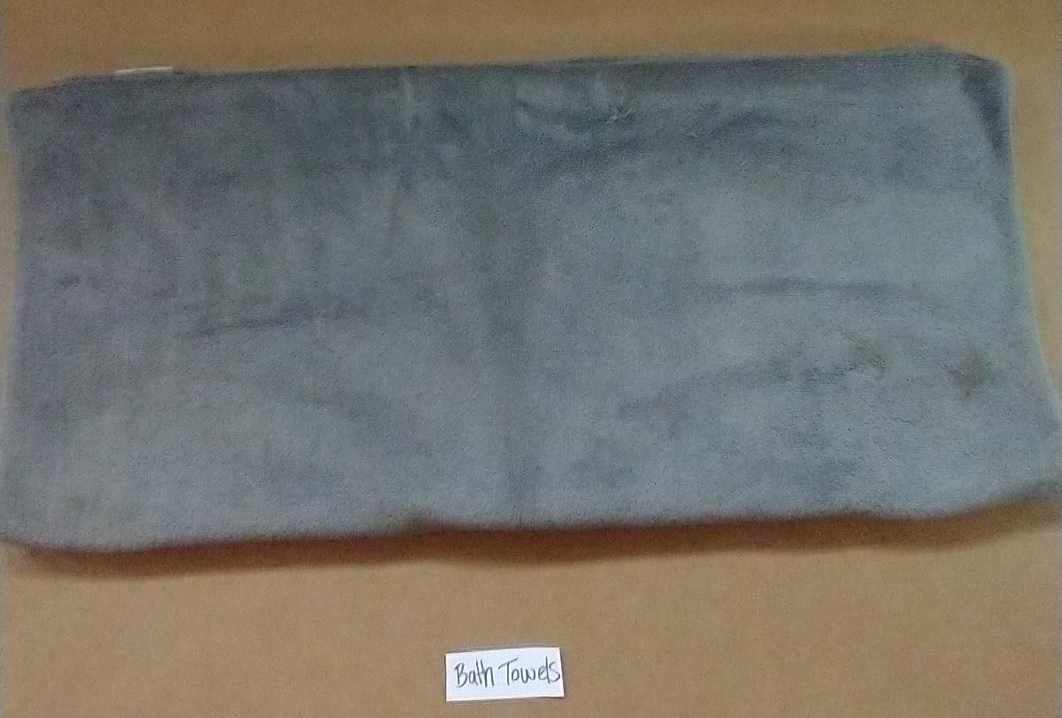
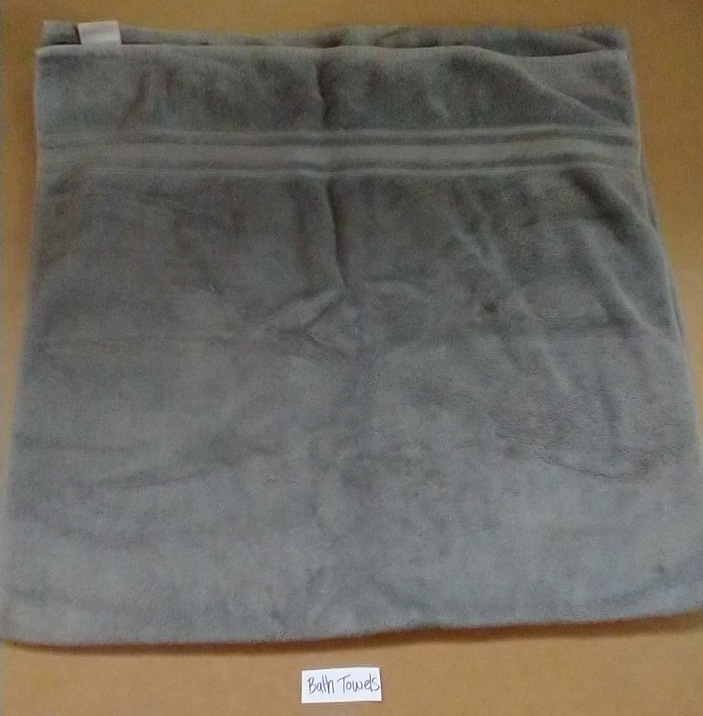
Bath Towels
Make it look just like mine.
3
1
2
Look like mine?
Yes
No
4
5
6

Slide 8
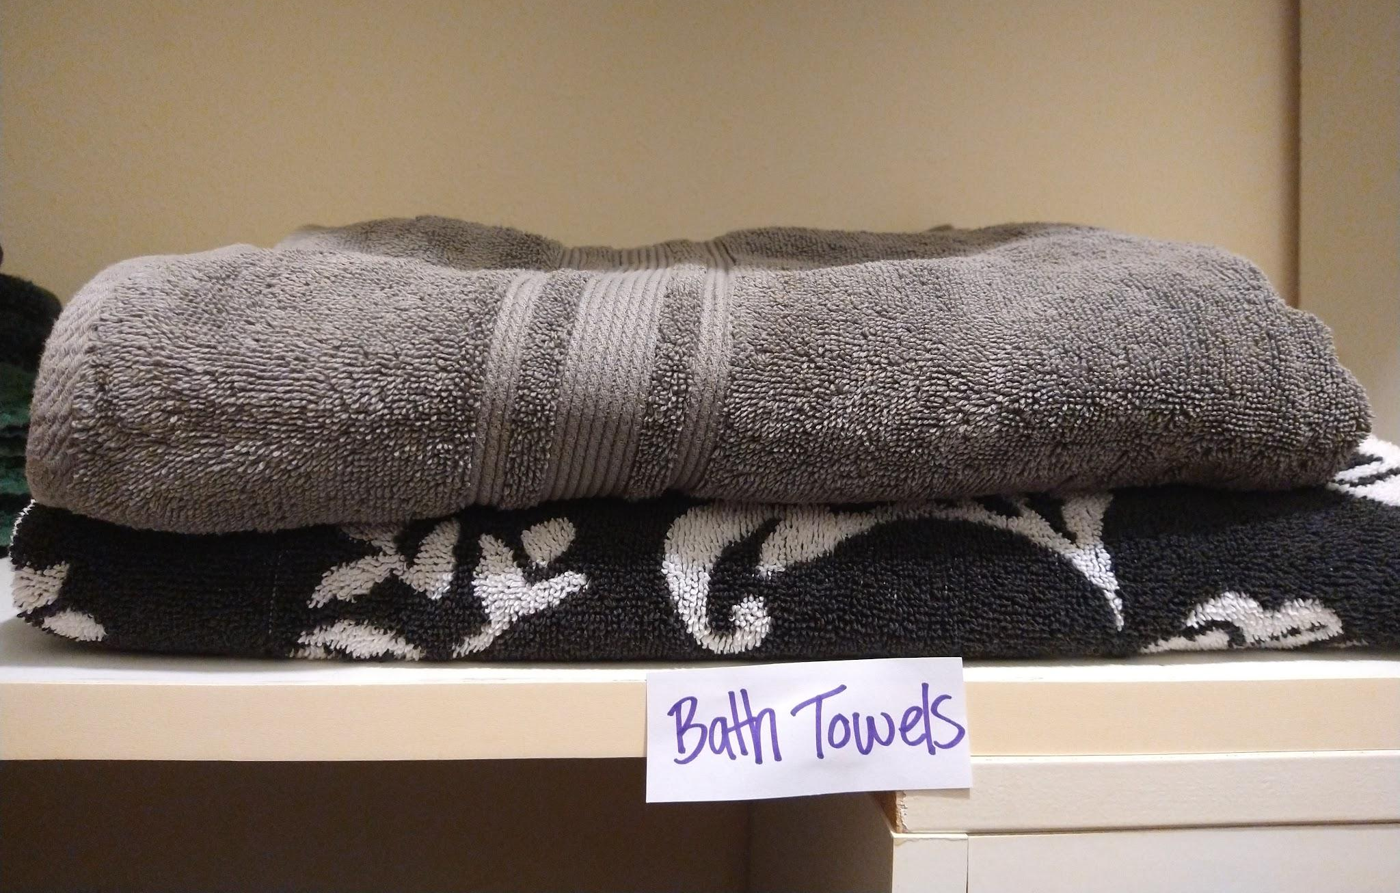
Bath Towels
Put away in closet.

Slide 9
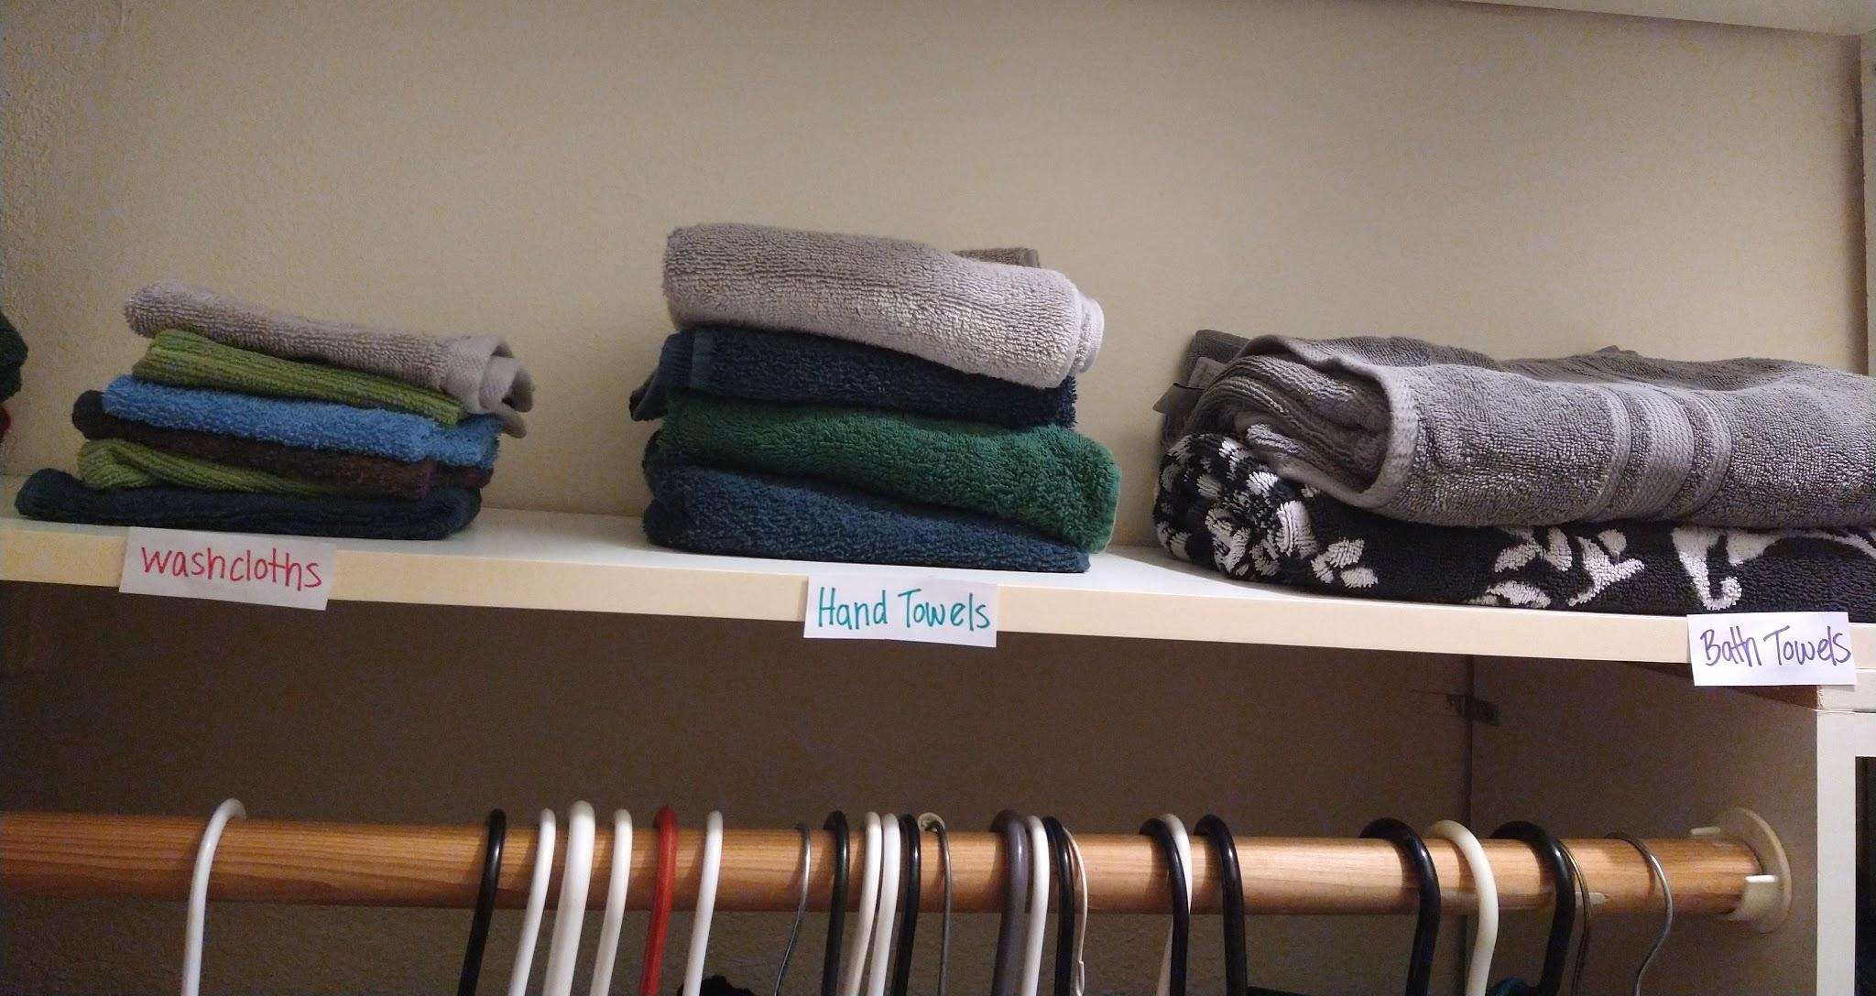
Washcloths & Hand Towels & Bath Towels
Put away in closet.

Slide 10
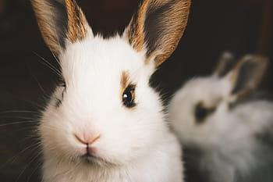
All done! Good Job.
Notes:
Client this tool was made for loved rabbits.

